Slide 1
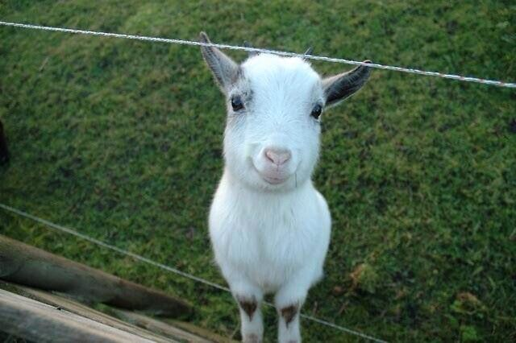
Hi

Slide 2
Horosgoat
Wish me goat luck!

Slide 3


Horosgoat
Input Twitter data + date of birth

Slide 4
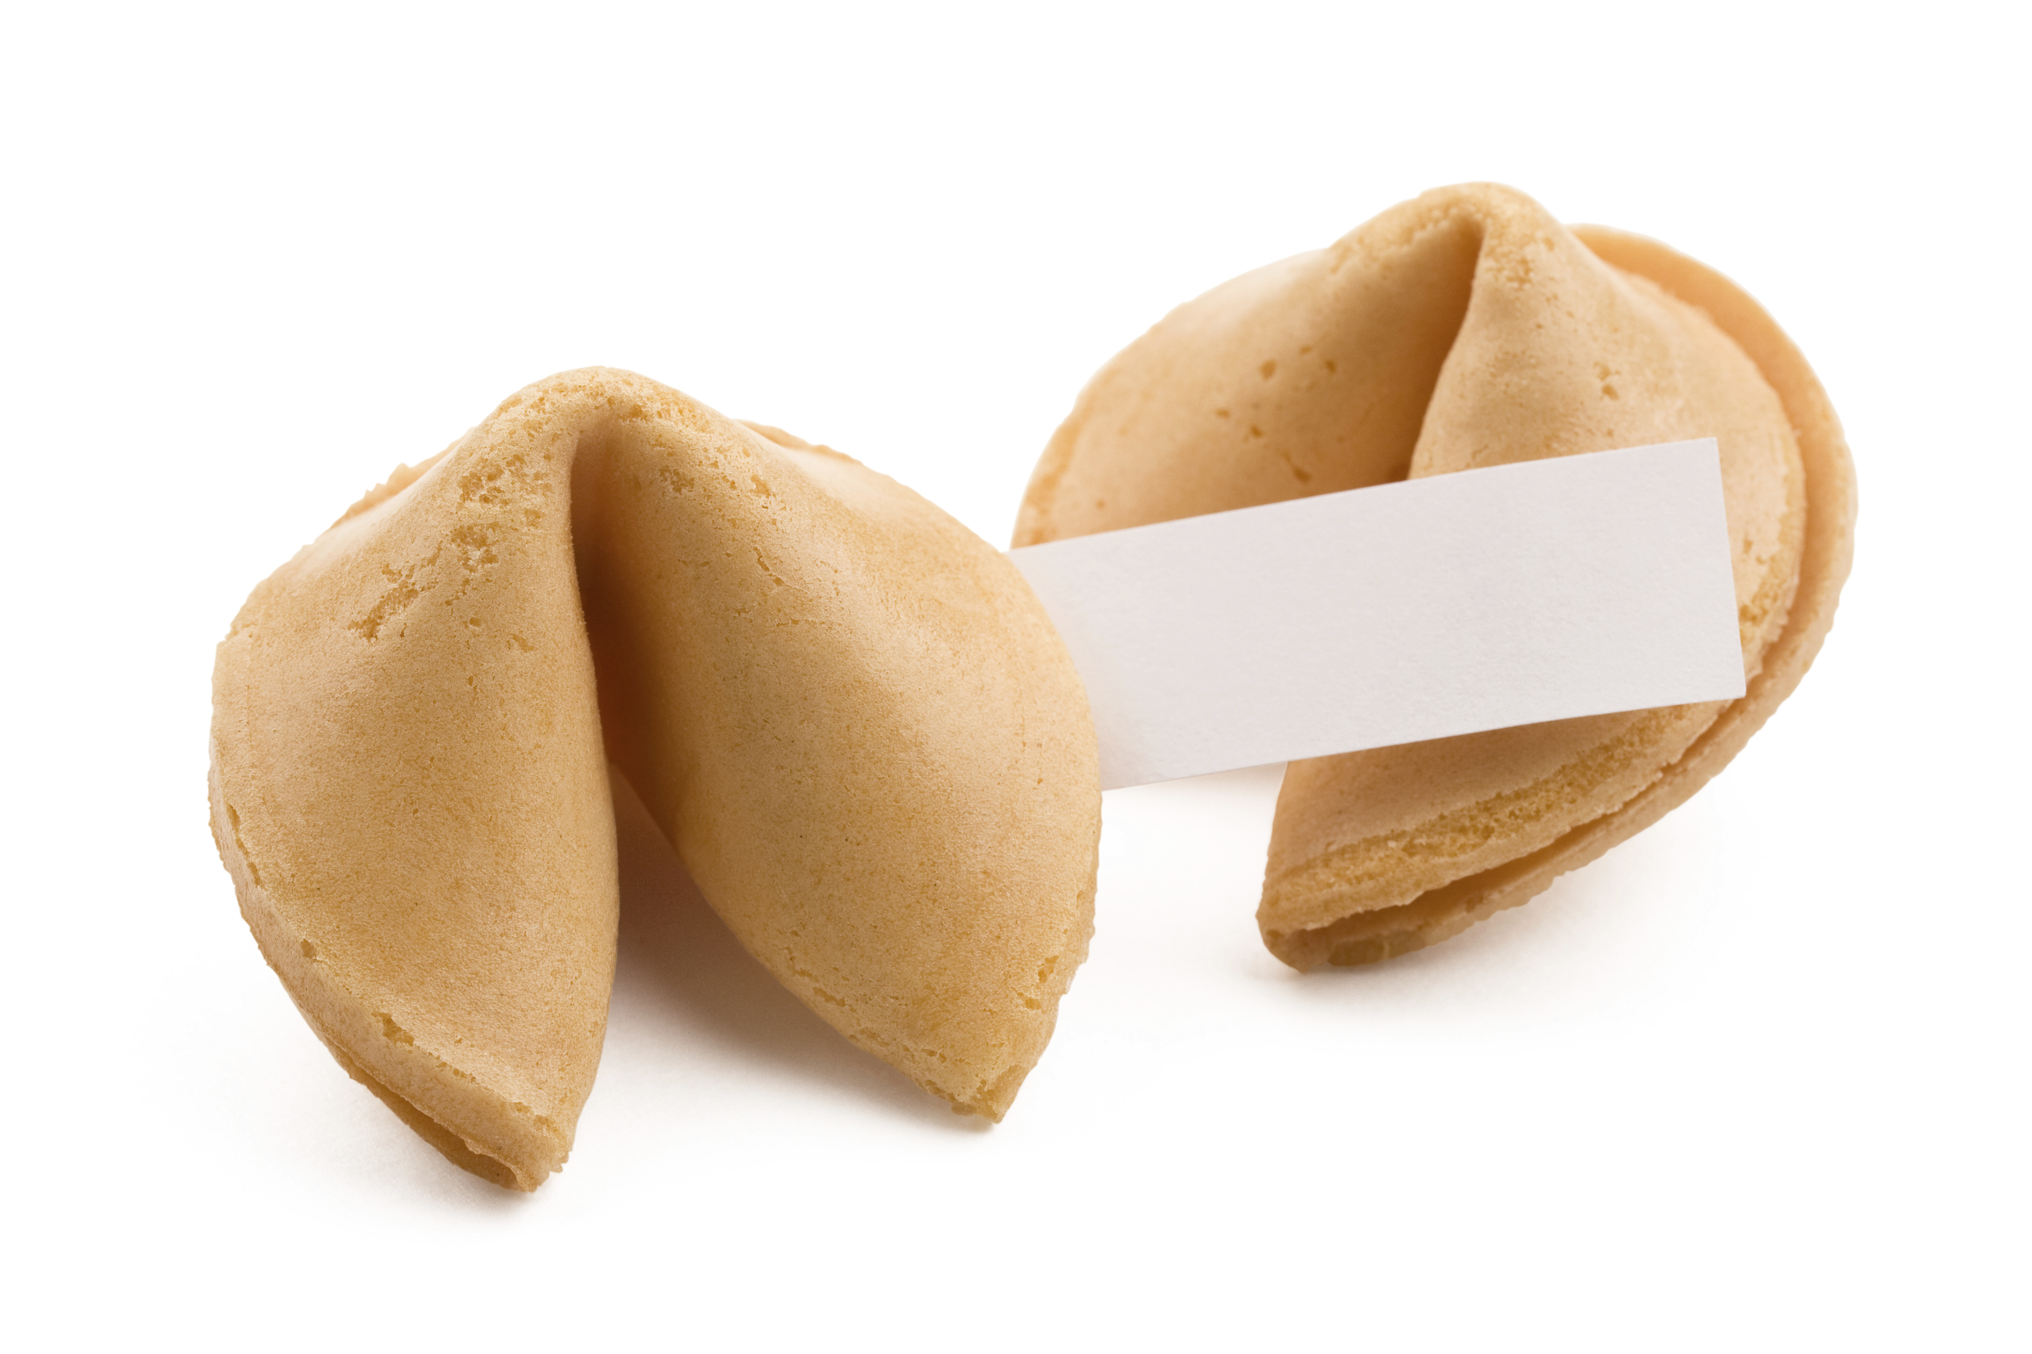
Horosgoat
Receive random fortune cookie at Chinese New Year
±19 Feb (± 2015 = year of the goat)

Slide 5
Horosgoat
Tweet fortune to the name in the cookie
Receive your own from other people

Slide 6
Horosgoat
Cookies will be available in iroom/foyer for participants
Limited to MCT (for now)

Slide 7
Thank you
sooooooo
much
for listening

